Slide 1
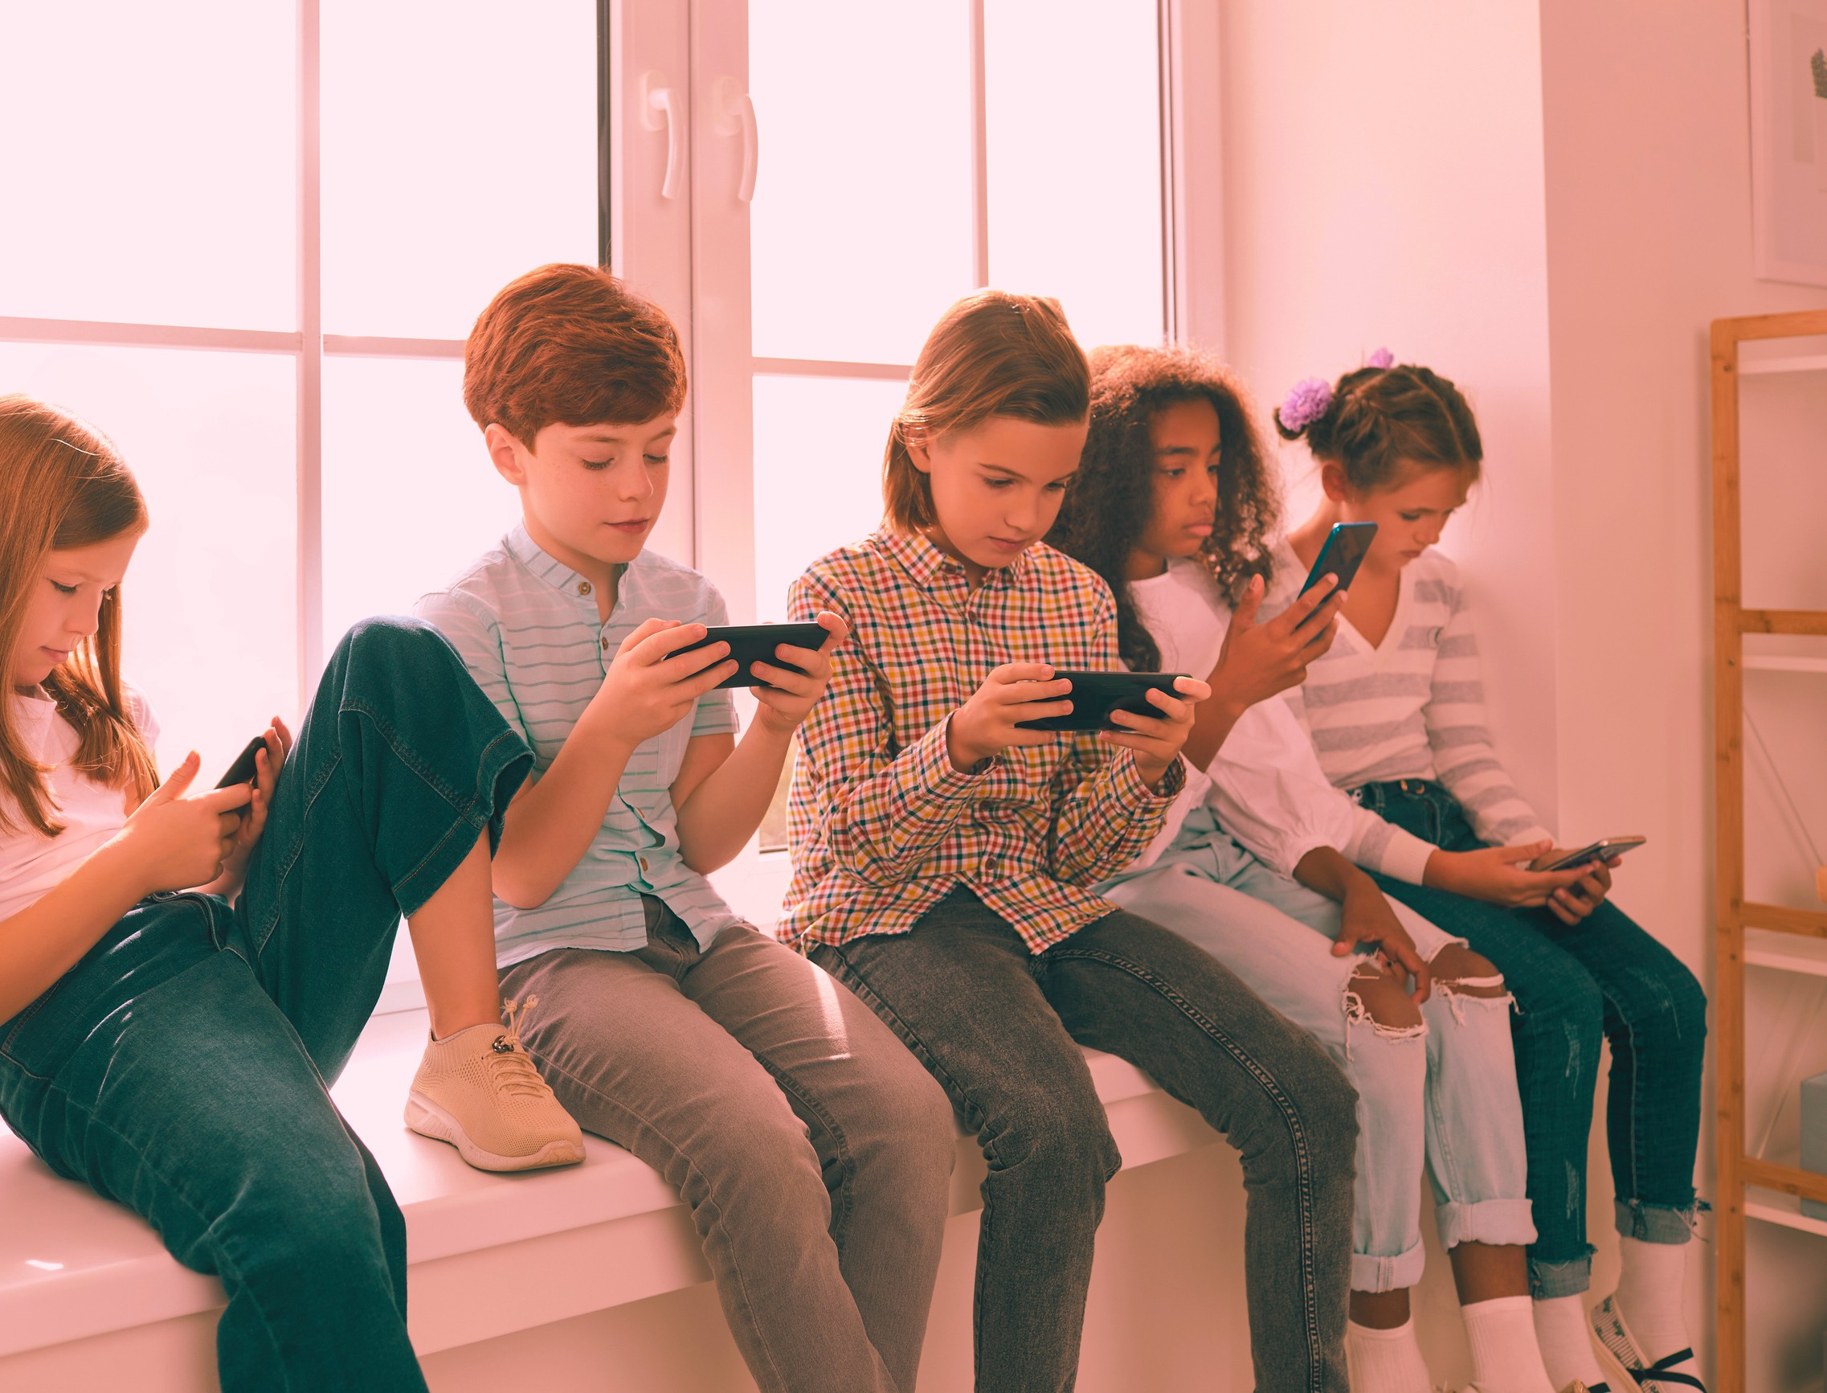


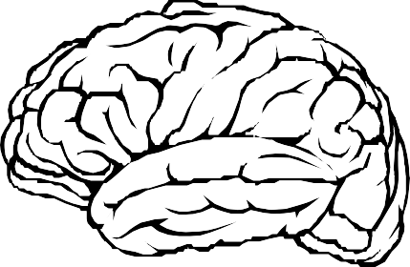
"ARE CHILDREN SMARTER BECAUSE OF THE INTERNET?"

Slide 2

MAJOR QUESTIONS
Do you use Educational Websites/Videos to learn about your subject?
How do the educational contents affect your learning process?
Do you think Internet can improve your cognitive/thinking abilities?

Slide 3
HYPOTHESIS
The common hypothesis is that a rising number of children have access to the Internet which is conducive for their intellectual growth and social skills as the use of Internet develops analytical skills, significant abilities, and academic perspective. However the lasting impacts of this technology have been questioned in the essence of its influence on societal functioning and increasing reports linking psychological addictive characteristics to Internet use. Also most parents are unaware of the fact how Internet is beneficial for their child as they significantly take into account the adverse effects of it.

Slide 4
RESEARCH METHODOLOGY

Slide 5
DO YOU USE EDUCATIONAL WEBSITES/VIDEOS TO LEARN ABOUT YOUR SUBJECT?
Never 4%
No, it is not needed 12%
Yes , all the time 54%
Yes, sometimes 30%

Slide 6
HOW DO THE EDUCATIONAL CONTENTS AFFECT YOURLEARNING PROCESS?
40
30
20
10
0
I enjoy it as it is easy to understand I enjoy it but it takes time to understand
I prefer face to face explanation
I do not like studying online

Slide 7
DO YOU THINK INTERNET CAN IMPROVE YOUR
COGNITIVE/THINKING ABILITIES?
No, it has nothing to do with improving cognitive skills 2%
Yes, but I can't relate 28%
Yes, I can relate 70%

Slide 8
CONCLUSION
The research supports the growing number of children using the Internet and such exposure at an early age indicates that Internet might be helpful in improving cognition and critical review skills, whilst displaying a more advanced understanding of both virtual and real worlds. This proves the hypothesis to be right and thus can be inferred that the Internet is actually making children smarter. Children who use the Internet regularly might also display a more proactive approach to information gathering and improved performance in visual learning which will result in children having stronger memory, comprehension and abstract thought. It also becomes imperative for the parents to acknowledge that the Internet can do more good than harm. The research actually revealed that parents are indeed aware of the positive impacts of the Internet and hence willing to let their children use it.

Slide 9


